Slide 1

Exploratory Data Analysis
G2M insight for Cab Investment firm
11/19/2023

Slide 2

Agenda
Executive Summary
Approach
EDA
EDA Summary
Recommendations

Slide 3
Executive Summary
* This data analysis project aims to provide actionable insights for XYZ, a private firm in the US, considering an investment in the rapidly growing cab industry.
* The analysis leverages multiple datasets covering the period from 31/01/2016 to 31/12/2018, with a focus on two cab companies.
* The goal is to assist XYZ in identifying the most promising investment opportunity based on a thorough investigation of customer behavior, company performance, and external factors.

Slide 4
Approach
Understanding the Business Context
Exploratory Data Analysis
Data Preprocessing
Data Integration
Hypothesis Generation and Investigation
In Depth Analysis

Slide 5
EDA (Exploratory Data Analysis)
Load and Inspects 4 datasets
Understand Variable Distributions
Identifying and Handling Missing Data
Exploring Categorical Variables
Outlier Detection
Company Comparison

Slide 6
DataSets
We have 4 datasets:
Cab Data
Customer ID
Transaction ID
City
From these 4 datasets we created master dataset combining all the necessary features.
Transaction ID
Date of Travel
Company
City
Km Traveled
Price Charged
Cost of Trip
Customer ID
Payment Mode
Gender
Age
Income (USD/Month)

Slide 7
Missing Values
From the 4 datasets below:
Cab Data
Customer ID
Transaction ID
City
We didn’t find any missing values from the above datasets.

Slide 8
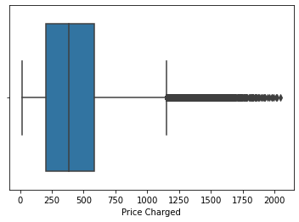
Outlier Detection
We have detected around 3000+ outliers by using box plot and z-score.
We applied z-score to the data where data points lies greater than +3 and less than -3 are considered as outliers.
Dropped all the outliers in the dataset.

Slide 9
Hypothesis
Which Cab company have higher number of customers?
Which City have the highest and lowest customers with respect to each company?
Which Cab company have highest profit?
Which company customers are prefering with age group of 40-60?
Average Customer monthly income of both the cab companies?

Slide 10
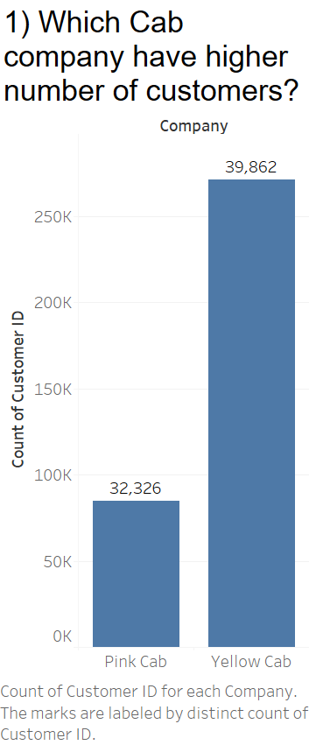
Hypothesis

Slide 11
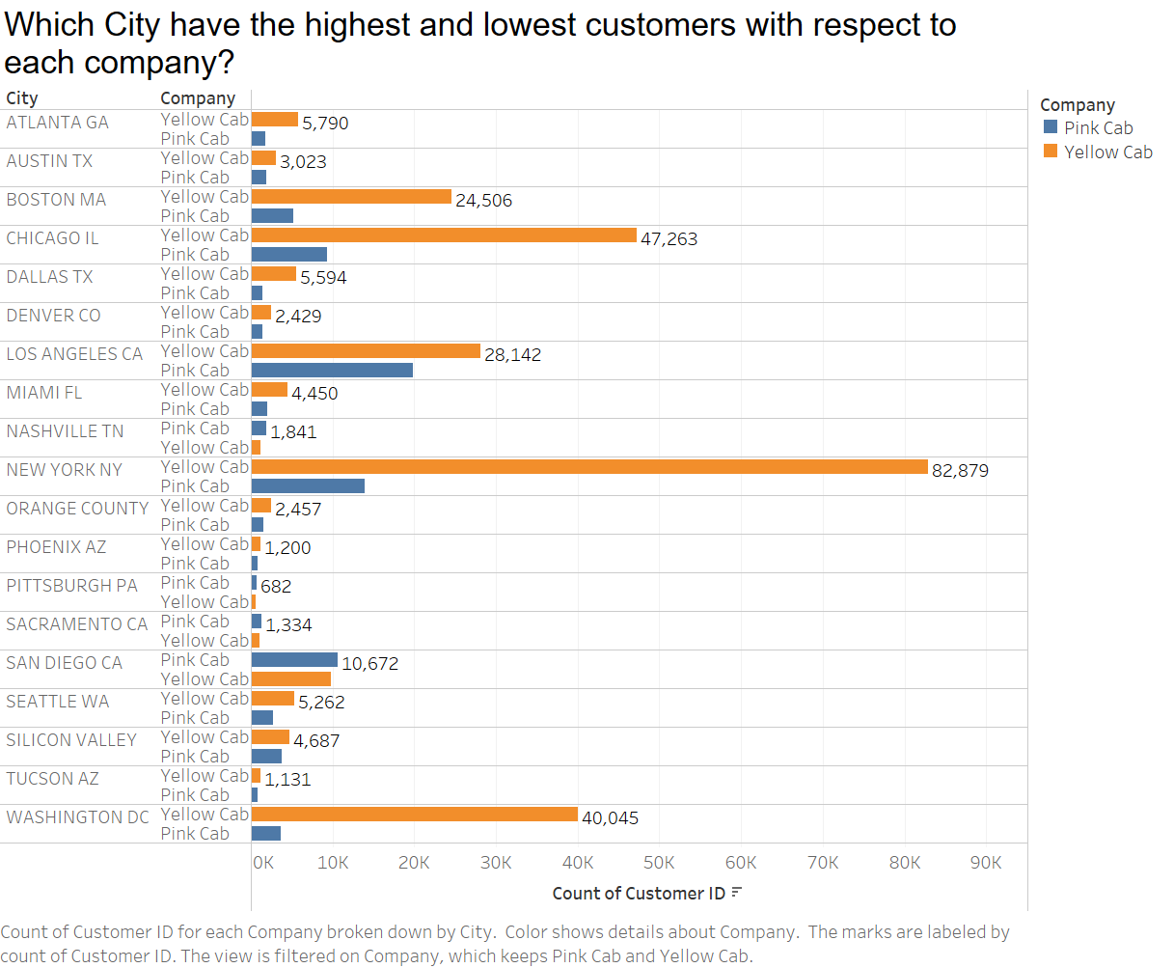
Hypothesis

Slide 12
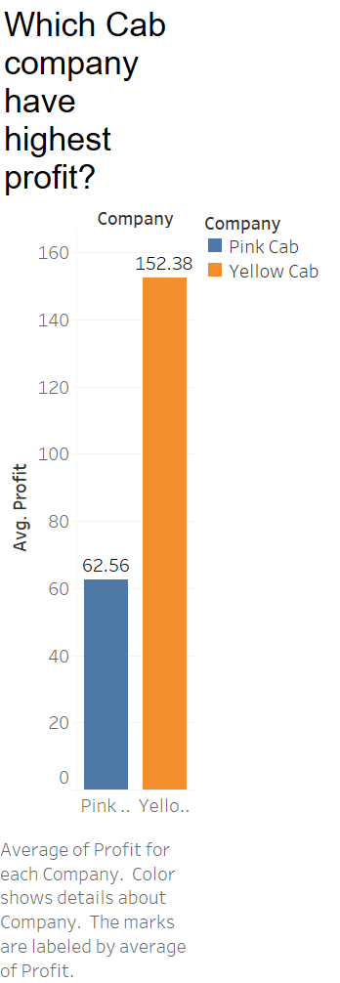
Hypothesis

Slide 13
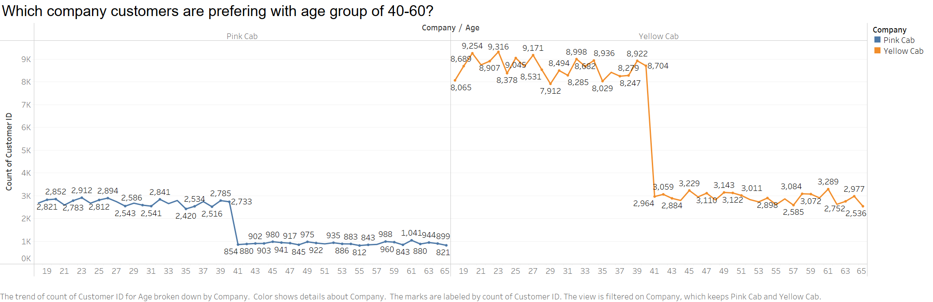
Hypothesis

Slide 14
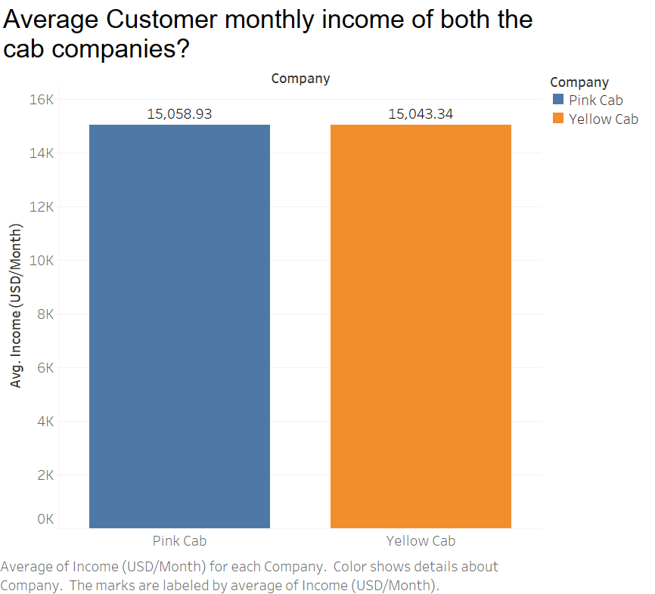
Hypothesis

Slide 15
Result
From the above analysis and hypothesis, we got to know that Yellow Cabs have the highest customer base in each any every city.
For the investment purpose, Yellow Cabs will the best company for the investment.

Slide 16
Thank You

